Slide 1

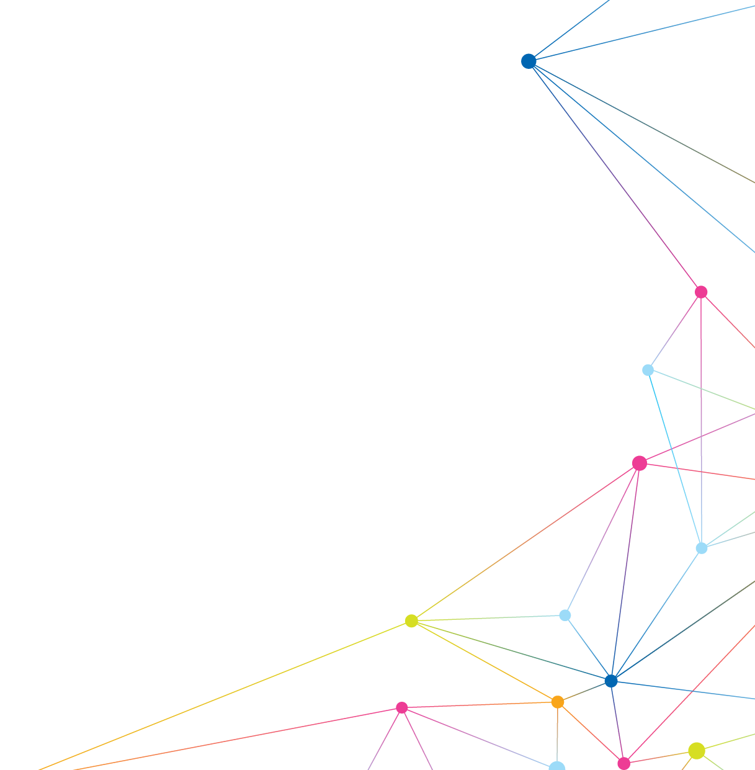

Introduction to Relational Databases
SQL Essentials
July 2020

Slide 2
GOAL 1:
Understand the definition of a database and explain what a DBMS does
GOAL 2:
Familiar with SQL Statements
GOAL 3:
Ability to JOIN tables

Slide 3
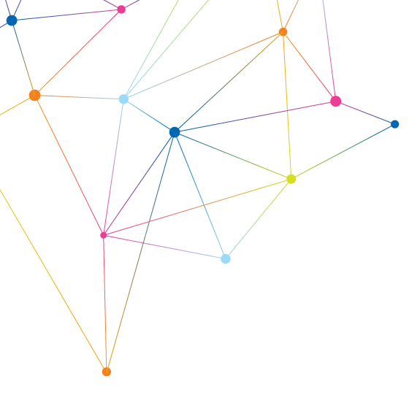
Contents
Introduction to Data and Database
Introduction to DBMS and RDBMS
Use Case Examples

Slide 4
Introduction to Data and Database

Slide 5
Introduction to Relational Databases
Data
WHAT IS DATA?
Data is a set of values of qualitative and quantitative variables. (Wikipedia).
Qualitative observation deals with data that can be observed with our senses: sight, smell, touch, taste, and hearing. They do not involve measurements or numbers. For instance, colors, shapes, and textures of objects are all qualitative observations.
Quantitative data is information about quantities; that is, information that can be measured and
written down with numbers. Some examples of quantitative data are your height, your shoe size, and
the length of your fingernails.
In simple words, data can be facts related to any object in consideration.
For example, name, age, height, weight, and so on, are some data related to each person.
A picture, image, file etc. also can be considered data.

Slide 6
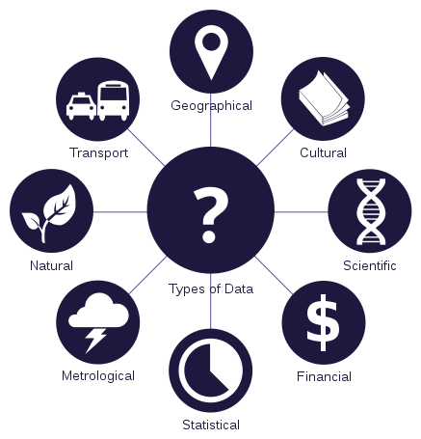
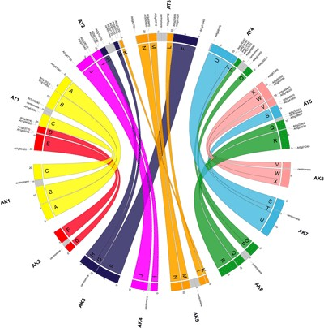
Introduction to Relational Databases
Data
TYPES OF DATA
You can find out more about biological databases on Wikipedia. https://goo.gl/fGjTdh
Wikipedia

Slide 7

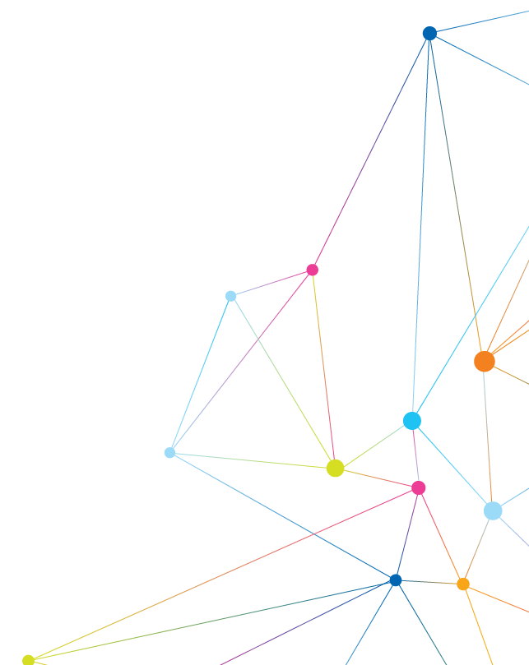


Introduction to Relational Databases
Database
Introduction to Relational Databases
Database
WHAT IS A DATABASE?
▪ Database is a systematic collection of data.
▪ Databases support storage and manipulation of data.
▪ Databases make data management easy.
WHAT IS A DATABASE?
Database is a systematic collection of data.
Databases support storage and manipulation of data.
Databases make data management easy.

Slide 8
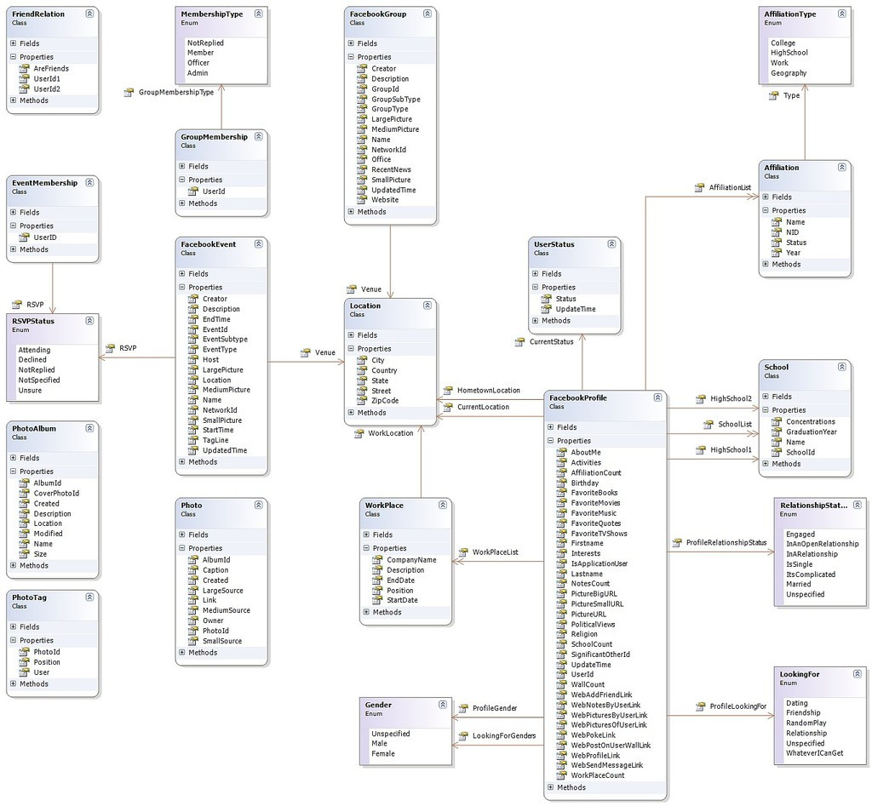
Introduction to Relational Databases
Database
DATABASE OF FACEBOOK
Facebook needs to store, manipulate and present data related to members, their friends, member activities, messages, advertisements and a lot more.

Slide 9

Introduction to Relational Databases
Database
WHAT IS THE PROBLEM?
Databases are designed to solve a problem, so what is the problem?
You can already store data, you can store your data in text files or spreadsheets.
You are also able to store and organize your documents in folders.
Just having data is not a good enough reason to need a database.
Having data is not the problem, the problem is what comes next?

Slide 10
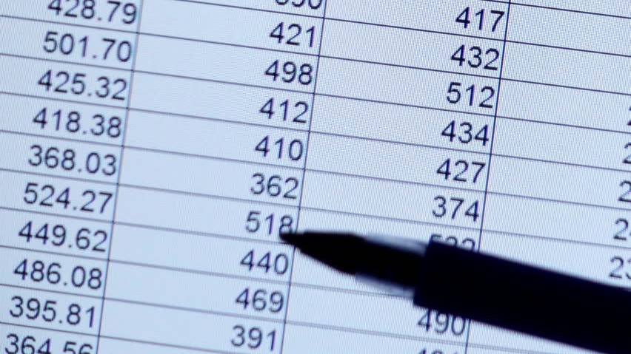
SPREADSHEETS
Introduction to DBMS
Database

Slide 11
WHAT ARE THE PROBLEMS?
Introduction to Relational Databases
Database
Size
Ease of
Accuracy
Updating
Security
Redundancy
Importance
Notes:
Problems of using spreadsheets to store data

Slide 12
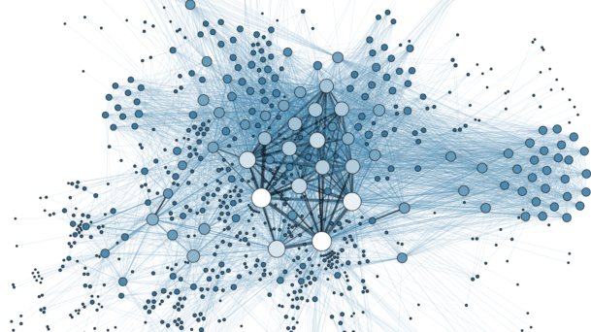
Introduction to Relational Databases
Challenges For Not Using Database
SIZE
When data grow up, the speed will reduce and finding a specific data won’t be easy.
Notes:
If 2 M rows of data, cant even load/open the data
So we need a fast way to retrieve data

Slide 13
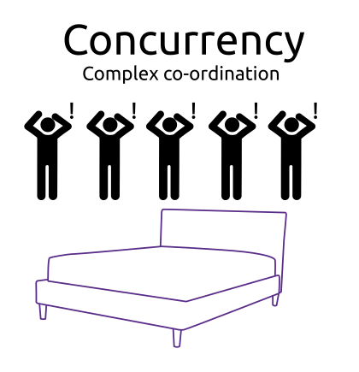
Introduction to Relational Databases
Challenges For Not Using Database
EASE OF UPDATING
What happens if two or more people want to edit a spreadsheet at the same time?
If you use flat files, something like spreadsheets, you can not manage concurrent editing.
Notes:
Concurrency problem
5 ppl want to sleep on the bed (diagram above)
What to do if 5 ppl update a cell at the same time

Slide 14
Introduction to Relational Databases
Challenges For Not Using Database
ACCURACY
Is there anything that would actually prevent us from typing incorrect data in a spreadsheet?
Notes:
Phone number format, address,
In database, we can control everything that we want to make sure we have accurate data at the end

Slide 15
Introduction to Relational Databases
Challenges For Not Using Database
SECURITY
Sharing a data file with someone doesn’t mean it needs to be shared with everyone.
Some of data could be sensitive (for example, payroll information, health care information, etc).
Who can share it, who can edit it, and who can delete it
Another important thing that we want to know is the last person who edited this file, who made every entry and every change at every position.
What’s the reason? Because in some cases we have to audit every alteration to sensitive data.
Notes:
Authorization, ….
1. autthorization
2.
3. Want to know the person editing that data- data history

Slide 16
Introduction to Relational Databases
Challenges For Not Using Database
REDUNDANCY
Redundancy means duplication of your data or having multiple copies of the same data.
Redundancy by itself is not a bad thing. With backup, it is good to have redundancy.
BUT! Redundancy in the data itself, not so good, because it leads to conflicts.
product_id | product_name | … | price
101 | TEA | … | $10
101 | TEA | … | $12
Notes:
Redundancy – duplicated data
Good – can store the backup somewhere else and if anything happen to the original, we can still have the copy
BAD – leads to conflicts, in example TEA - $10/ $12 – which one is correct

Slide 17
Introduction to Relational Databases
Challenges For Not Using Database
IMPORTANCE
What's your opinion about if the
What should we do if we lose
information you just lost was
some part of information that
yesterday's orders or allergies of a
we've entered before?
patient, or the details of a stock
trade?
Notes:
His experience - Organizations in Sarawak (lots of branches in Sarawak)
Store data in USB/Flash memories – excel.
Each branch store in pendrive and send them to HQ
What happen if we lose it, not significance to small company, but if big company like petronas or shell

Slide 18
Introduction to Relational Databases
Challenges For Not Using Database
ANSWER
THAT'S NOT INCONVENIENT!
UNACCEPTABLE!
THAT'S
Notes:
- We do not want lose even a bit of our data. So we want to keep our data in secure device/structure

Slide 19
Introduction to Relational Databases
Reasons to Use Database
WHY DO WE NEED DATABASES?
Databases are able to address these problems:
Size
Ease of Updating
Accuracy
Security
Redundancy
Importance

Slide 20

SO, WHAT DO WE WANT?
Introduction to Relational Databases
Reasons to Use Database
When the data are growing they still be manageable
Data should be easily updatable even by lots of people at the same time
Keeping data accurate and internally consistent
Keeping it secure and controlling access to it, for example who gets to read it, who gets to edit it, and tracking exactly what and when they did it
THERE IS ONE VERSION OF THE TRUTH.
^{W}ne^{h}ve^{n}r ^{e}lo^{v}s^{e}e^{r} th^{yo}a^{u}t ch^{m}aªn^{k}g^{e}e o^{c}r^{ha}lo^{n}s^{g}e^{e}yo^{to}ur data.^{, you'll}

Slide 21

Introduction to Relational Databases
Reasons to Use Database
WHAT CAN A DATABASE GIVE US?
Structure

Slide 22
Introduction to Relational Databases
Rules Of Structure
This structured system imposes rules upon your data.
The rules are yours, because the importance of these issues changes based on your need.
May be your main problem is size, you have terabyte of information that you’ll have different priorities from someone who has much smaller amount of data, but every single change must be controlled, audited, and logged the moment that’s it made.

Slide 23
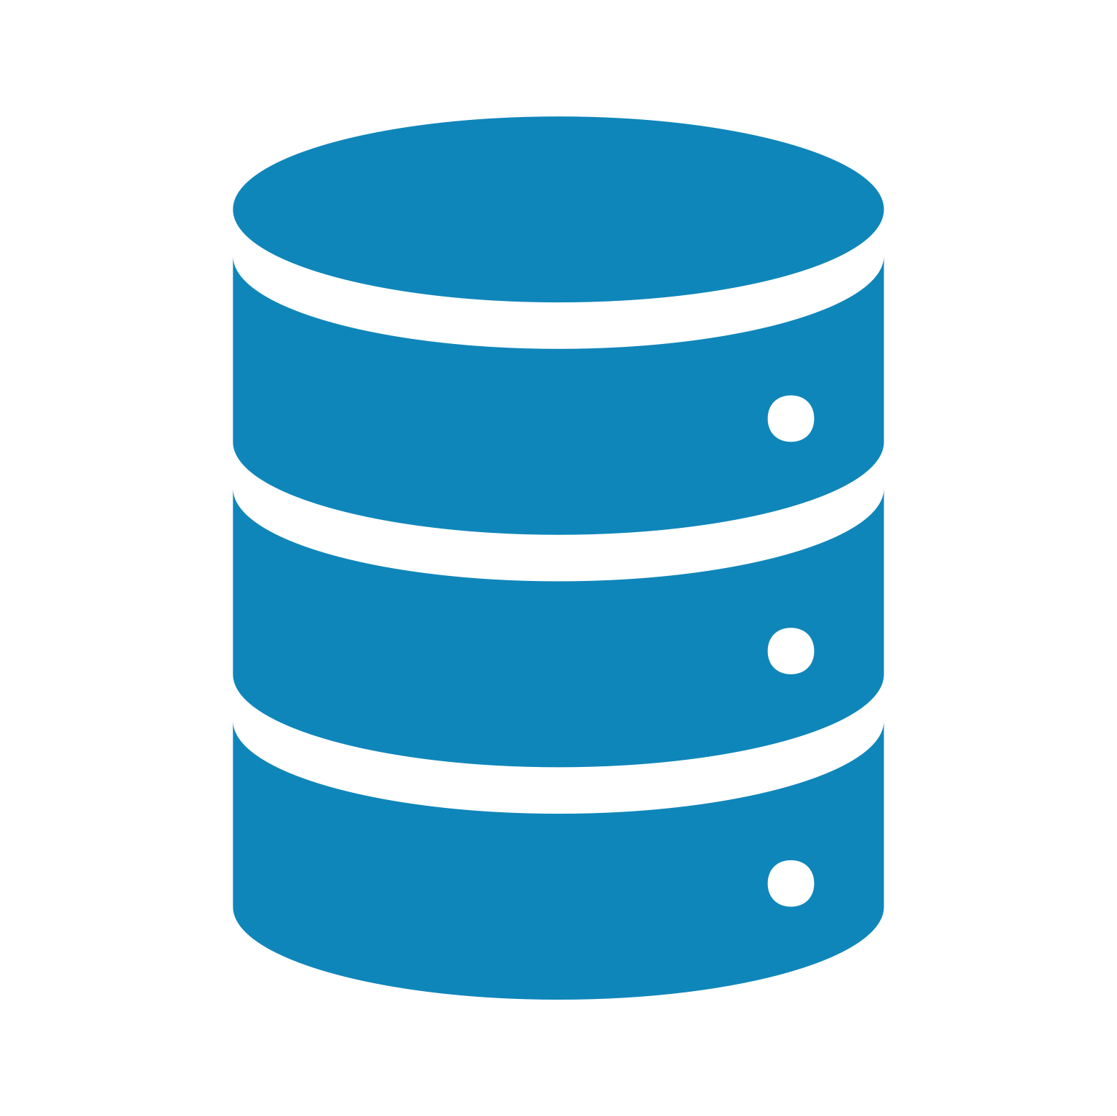
Introduction to Relational Databases
Rules Of Structure
The true power of database is…
Notes:
P0owerfuul tools to orghannize/manage your data

Slide 24

Introduction to Relational Databases
Rules Of Structure
Invisible
Notes:
They are transparent. Don’t need to deal with the technical aspect of these things. Only need to use the tools around the database and do anything tthat you want.
The true power is invicible

Slide 25
Introduction to DBMS and RDBMS

Slide 26
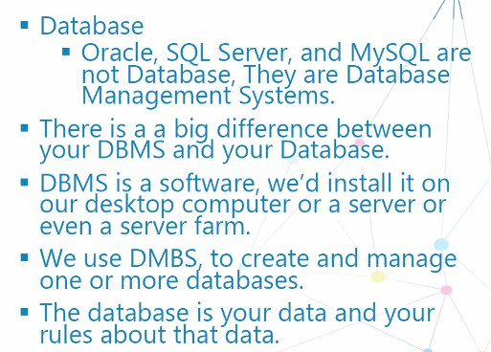
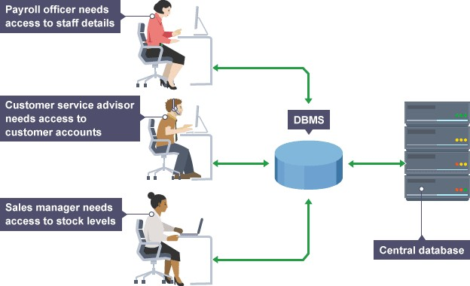
Introduction to Relational Databases
DBMS
DATABASE MANAGEMENT SYSTEM
Notes:
DB != DBMS
DBMS is the software app to manage DB
Example: MySQL, SQL server, Oracle
Database § Oracle, SQL Server, not Database, They aanred DMaytSabQaLs aer e Management Systems.
§ There is a a big difference between your DBMS and your Database.
§ DBMS is a software, we’d install it on eovuer nd ea ssketrovpe rc ofamrmpu. ter or a server or
§ We use DMBS, to create and manage one or more databases.
§ The database is your data and

Slide 27


Introduction to Relational Databases
DBMS
The database management system is the program or the set of programs that surround and manage our database (s) to make sure your rules are applied.
One DBMS can manage many different databases, each one separated from the others.
In the perfect world, you might imagine that an organization would have just one database that contains every scrap of information that is important for that company.
In practice, it’s very common to have multiple databases.
For example, a database that deals with your costumers and their orders information might be completely independent from your database that deals with human resources information.
Also, a company may use more than one DBMS, for example, they may use Oracle and SQL server, or even MySQL besides each others.
Notes:
Inventor of the 1st DBMS
Childs magman
Relational DB
Relational coz there is relation betw col & rows
3 tables – relationship betw table 1 and table 2 etc

Slide 28
Introduction to Relational Databases
Types of DBMS
Many DBMSs are fall into Relational DBMS.
Oracle, SQL Server, DB2, MySQL, etc.
Other types of DBMSs are:
Hierarchical
Network
Object-oriented
NoSQL
In this course, we are going to focus on understanding RDBMS. For some reasons…
It is the most widely used DBMS so far.
The principal that are used in all different types of DBMS would be more understandable if you know RDBMS.
Notes:
Most DBMS are Relational DBMS
This one, mostly RDBMS
RDBMS – store structured data (MySQL)
NoSQL – semi-structured data

Slide 29
Introduction to Relational Databases
Types of DBMS
RDBMS
A database is constructed of one or more tables.
Table is the most fundamental building block of a database.
A database without any table is just a shell, devoid of meaning.
All your data goes into tables.

Slide 30
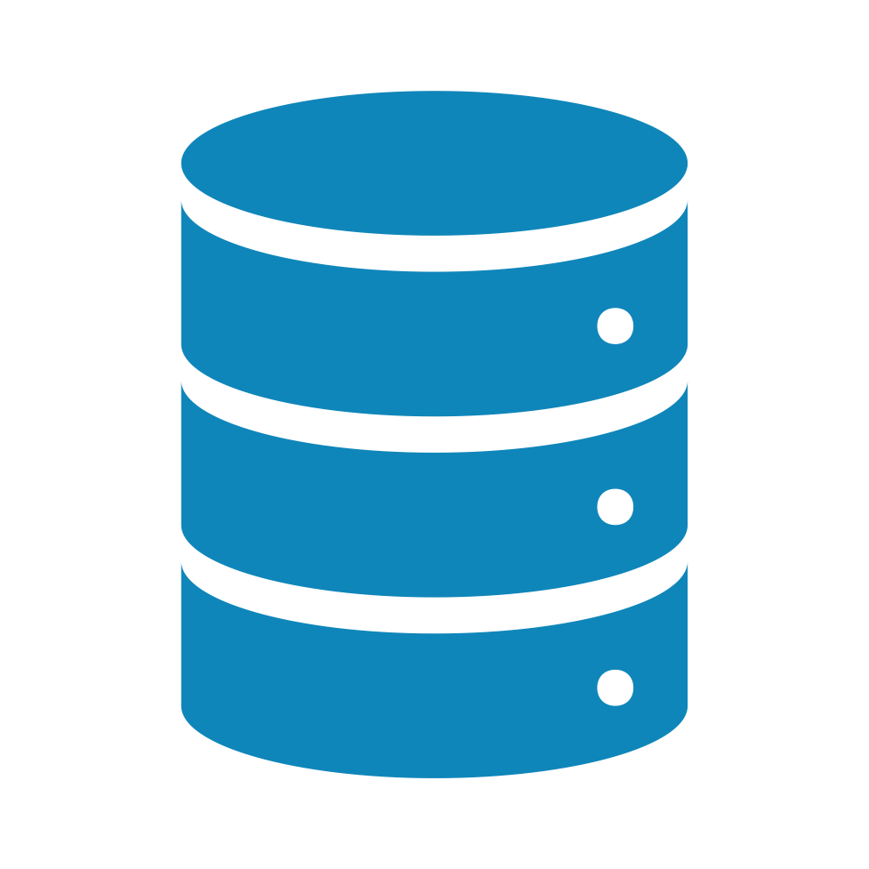



Introduction to Relational Databases
RDBMS
Sample database
Employees
Orders Customers

Slide 31
Introduction to Relational Databases
RDBMS
Column/Attribute
TABLE
Each table describes a formalized repeating list of data.
Visually, it’s often shown like a
Row/ Tuple
spreadsheet.
Each table consists of columns and rows.
By defining columns, we will apply a structure to data. And every row must obey this structure.
Notes:
Building blocks of DB are tables.
Structure of table: column and rows
Can define the columns
Each column has name and data type

Slide 32
Introduction to Relational Databases
RDBMS
SAMPLE TABLE
FirstName (text) | LastName (text) | HireDate (date) | Grade (numeric) | Salary (currency)
Alice | Smith | 4/4/2009 | 4 | 7500
Tom | Williams | 3/1/2010 | 6 | 8000
Bob | Brown | 11/12/2007 | 3 | 5500

Slide 33
WHAT IS A KEY?
Introduction to Relational Databases
RDBMS
1
2
3
A key is a value used
A key could be a single column or combination of multiple columns.
Columns in a table that are not used to identify a
to identify a record in
a table uniquely.
record uniquely are called non-key columns.
Notes:
Key – identify a record in the table uniquely
Key – can be single column or more – candidate key
Other columns – non-key columns

Slide 34
Introduction to Relational Databases
RDBMS
WHAT IS A PRIMARY KEY?
A primary key can not be NULL.
A primary key value must be unique.
A primary is a single column value used to identify a
database record uniquely.
The primary key values cannot be changed.
The primary key must be given a
value when a new record is inserted.
Notes:
2 kind of key
Primary key
2. composite key
Primary key
Single column to identify a record uniquely
Rules
Value cannot be null
Should be unique
Value given when new record created

Slide 35
Introduction to Relational Databases
RDBMS
WHAT IS A COMPOSITE KEY?
A composite key is a primary key composed of multiple columns used to identify a record uniquely.
In this table, we have two people with same name, AMIN, but they live in different places.
Name | Address | Position | Gender
Amin | Bangsar South | Data Scientist | Male
Amin | Ampang Park | Computer Engineer | Male
Composite Key
Names are common, so we need name and address columns to identify a record uniquely.
Notes:
Composite key
- From multiple columns to identify a record uniquely

Slide 36
Introduction to Relational Databases
RDBMS
WHAT IS A FOREIGN KEY?
A foreign key can be NULL
Foreign Key is a column (or collection of columns) in a
A foreign key can contain duplicate values
table to refer to the Primary Key of other table.
A key to link two tables together.
A table is allowed to contain more than ONE foreign key
Notes:
Foreign Kye
Column refers to other primary key of other table
Can have duplicated value
Can have more than 1 foreign key

Slide 37
Creating Relationships

Slide 38
Customer
Comment
You are organizing your database into individuals tables.
Many of these tables will need to know about each other.
Places
Order
On
Entity Relationship Diagram (ERD)
Blog Post
Contains
Order_Item
Belongs to
Refers to
Author
Product
Notes:
Most of the time not using diamonds diagram, just use line

Slide 39
Relationship (cardinality) Options:
One-to-Many
Many-to-Many
One-to-One
None
Notes:
80% one to many
20% many to many
Avoid one to one

Slide 40
One-to-Many Relationship
Customer |  | < Order

Slide 41
One-to-Many Relationship
Customer
<
Order
<
Address

Slide 42
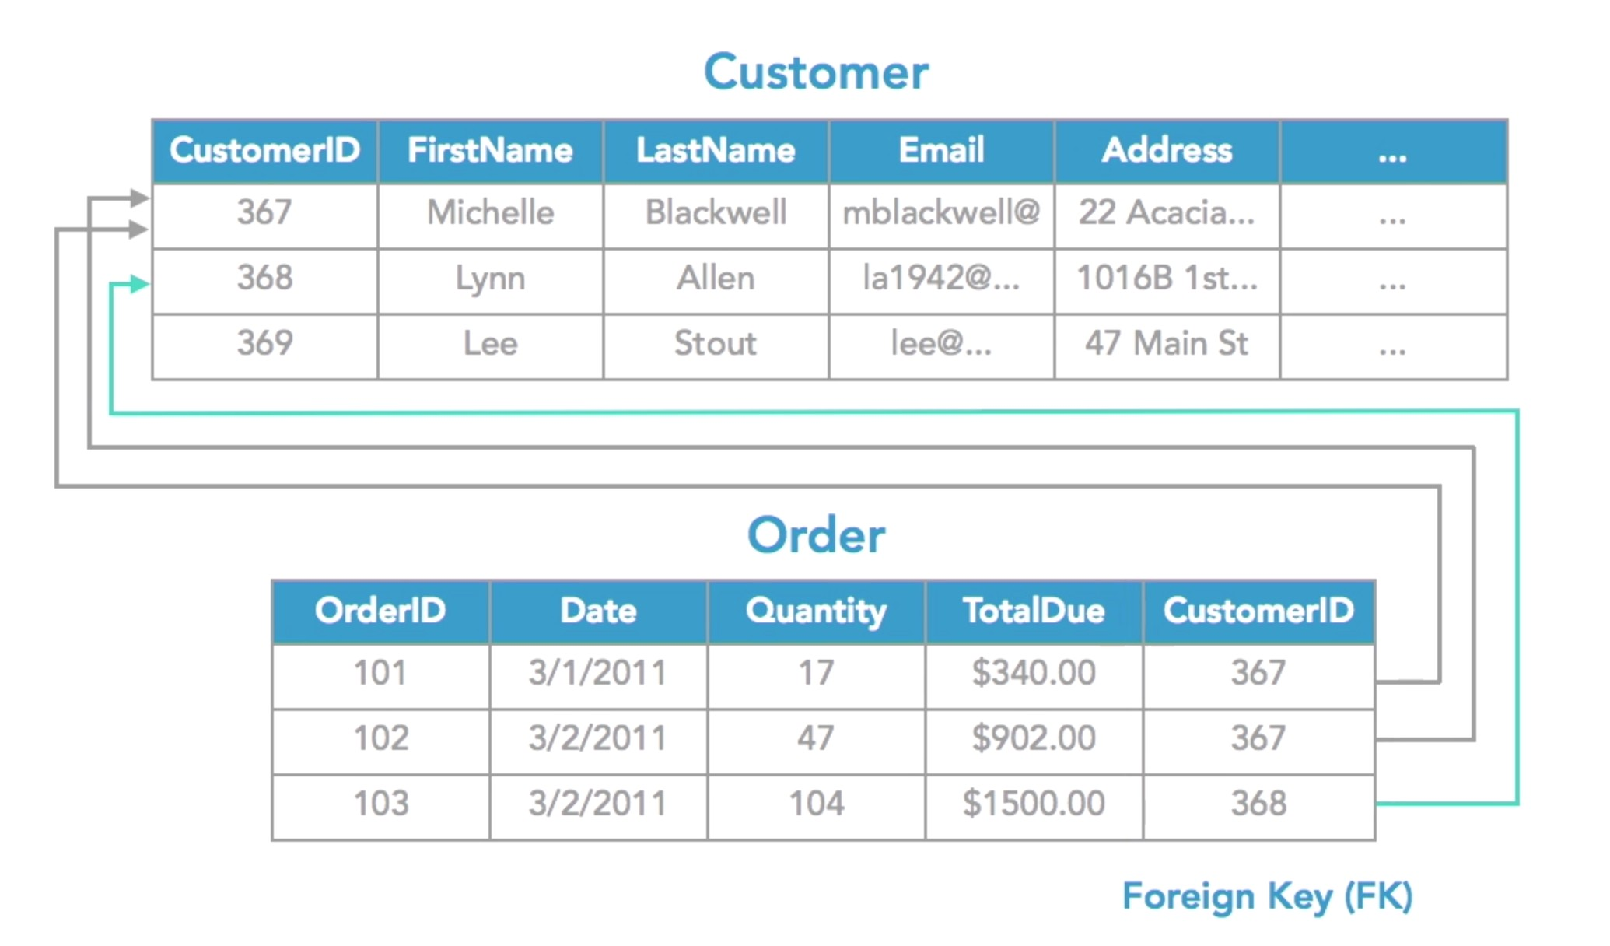
One-to-Many Relationship
Primary Key (PK)
Primary Key (PK)

Slide 43
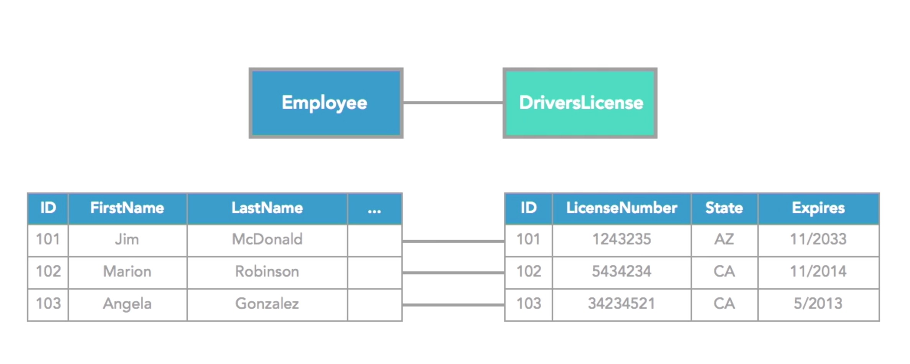
One-to-One Relationship
Notes:
Best practice just store them in the same table,
but we can do that

Slide 44
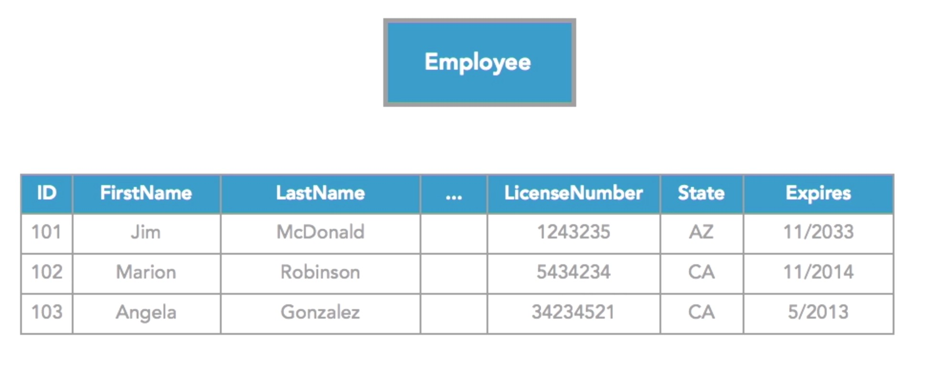
One-to-One Relationship

Slide 45
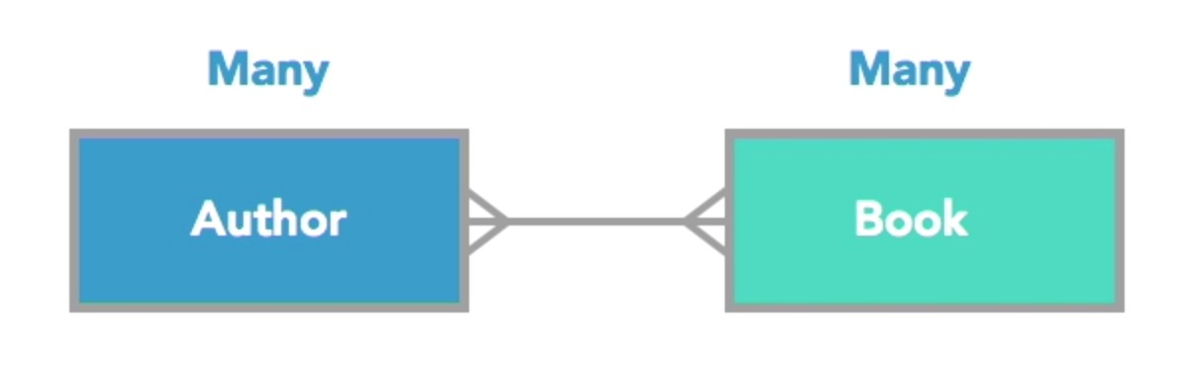
Many-to-Many Relationship

Slide 46
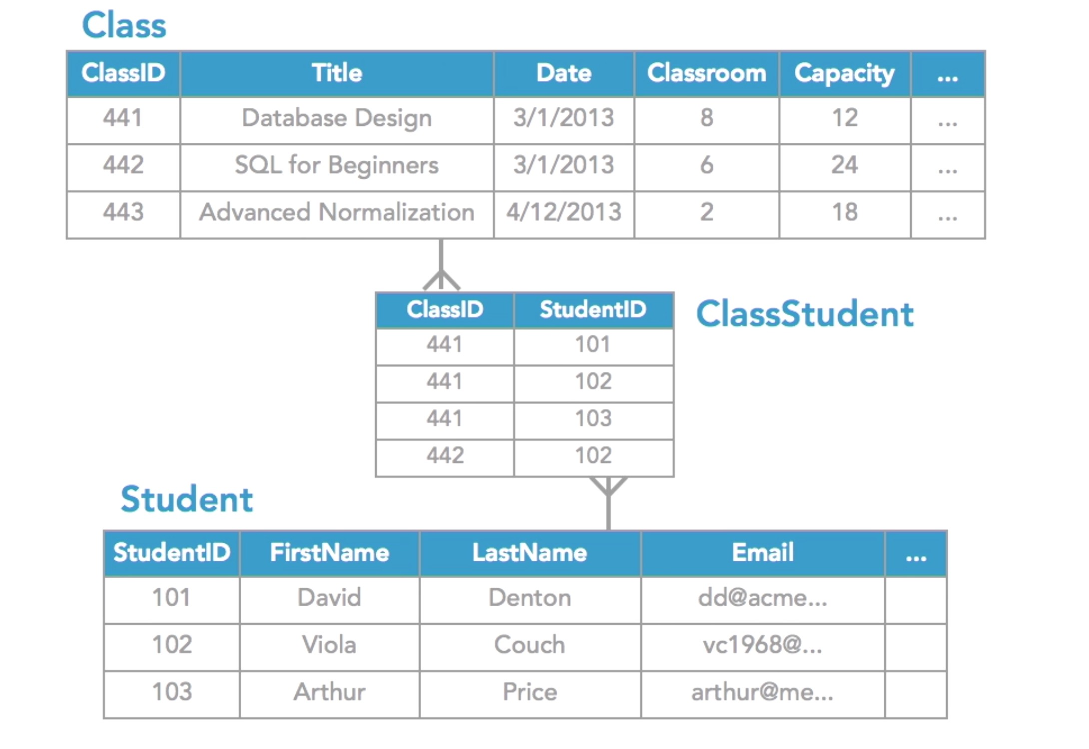

Many-to-Many Relationship
Linking Table
Notes:
For many to many, we need an extra table – linking table
Linking table:
Don’t need to have primary key
Not a composite key – don’t need to identify specific data

Slide 47
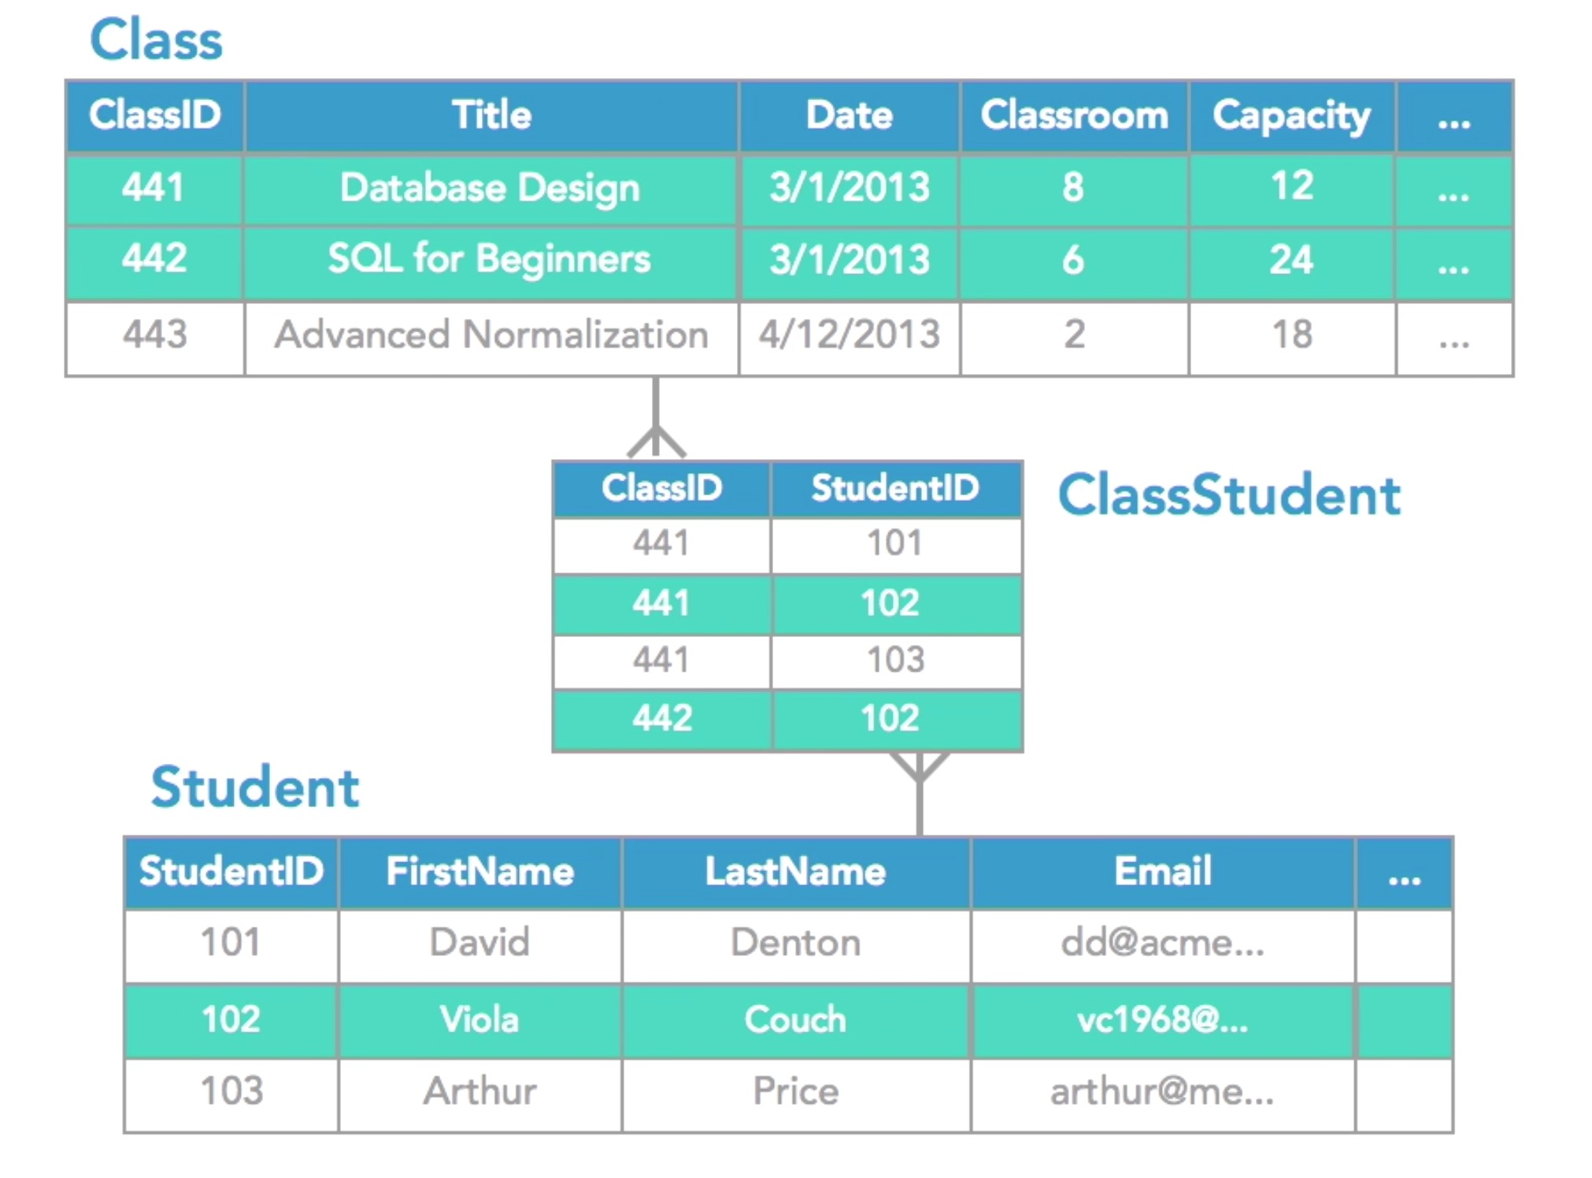
Many-to-Many Relationship
Linking Table
Notes:
This example:
cyan color
Many course for 1 student

Slide 48
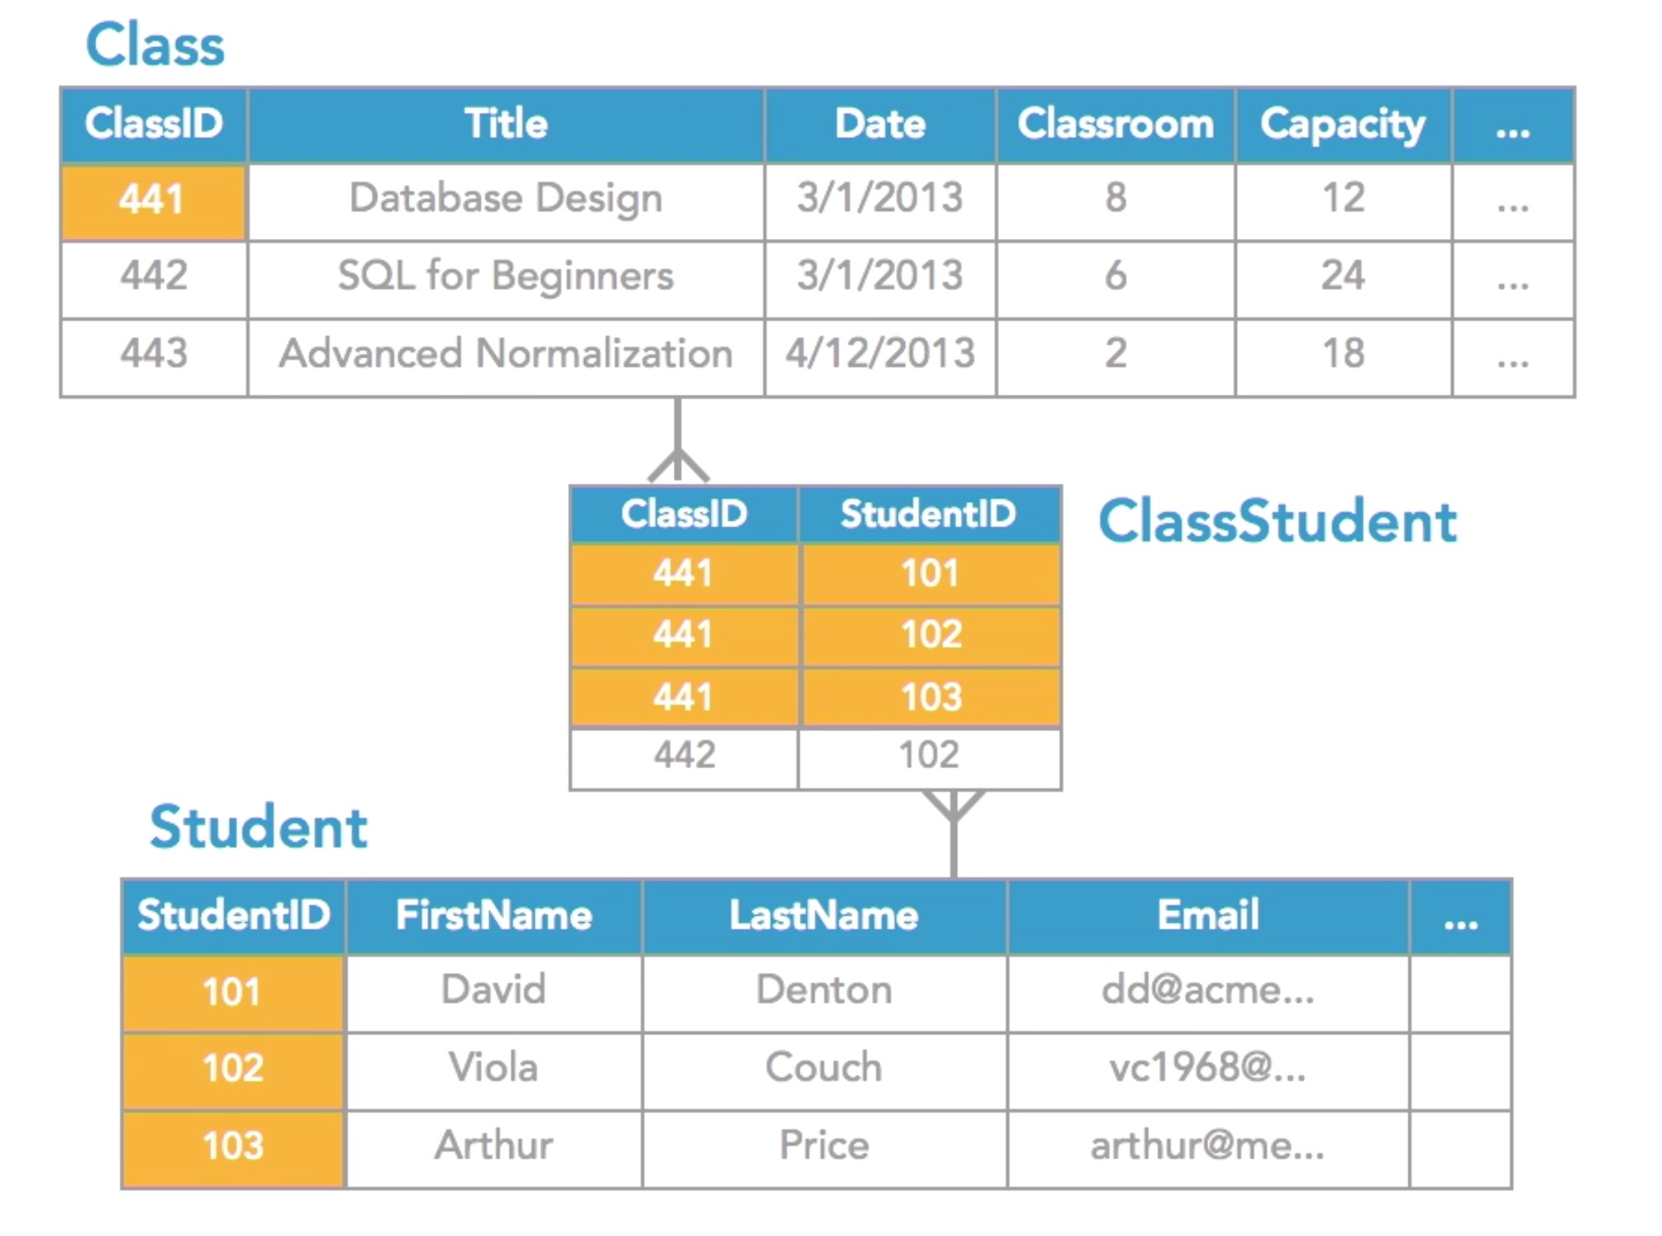
Many-to-Many Relationship
Linking Table
Notes:
This example:
orange color
1 course many student

Slide 49
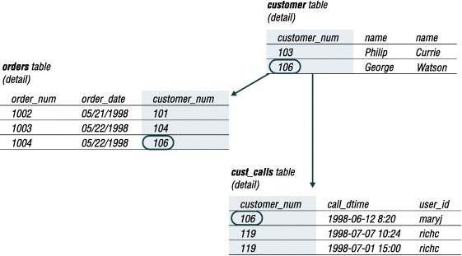
Referential Integrity
Notes:
If we delete a record in the parent table:
The child table that don’t have a parent record: we call them orphan record
If we want to delete the parent, we delete the children record first

Slide 50
Thank you.
: thecads.org
Qi info@thecads.org
n The Center of Applied Data Science
� thecads.org
'!I thecadsmalaysia

